Slide 1


GIT & GITHUB
VENKAT BANDI

Slide 2



What is GIT ?
It is a Distributed Version Control System.
It helps in tracking changes in files and coordinating work among multiple collaborators.

Slide 3
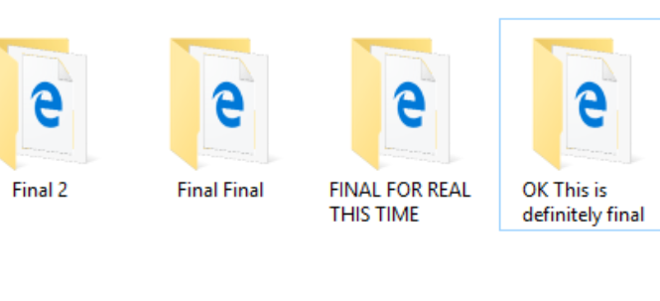
What is a Version Control System ?
Version control systems keep track of every modification to source code in a special kind of database.
They offer ways to go back to earlier revisions and compare code snippets to isolate breaking changes.

Slide 4
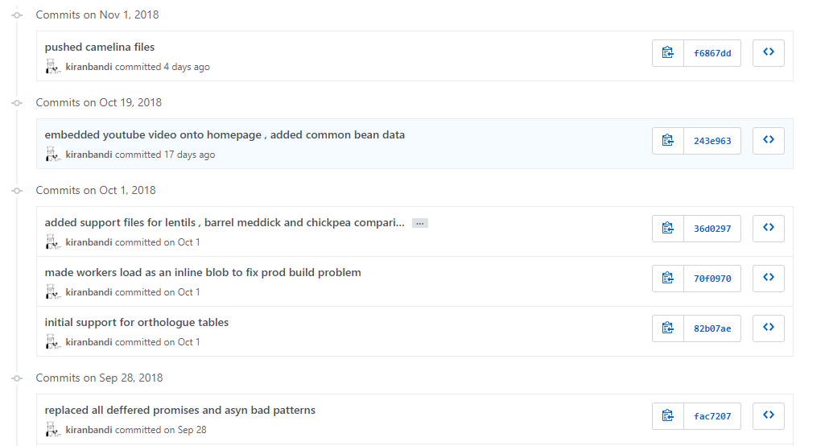
Advantages of using a VCS
A complete history of every file - Who made what change , when and why ?

Slide 5
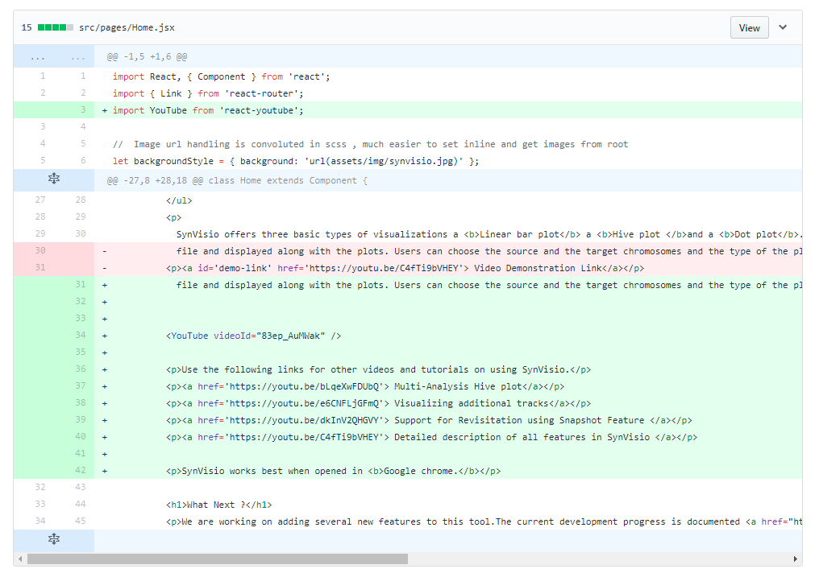
Track Changes

Slide 6


Advantages of using a VCS
Branching and Merging - Multiple streams of work on the same codebase without conflicts
Traceability - Facilitate long term design of the project by creating snapshots of major changes and releases.

Slide 7
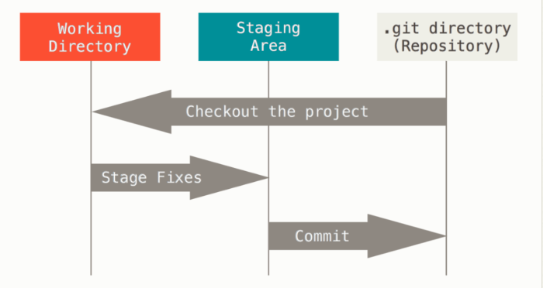
Basic Git Workflow ?
Change : You modify files in working tree.
Stage : You selectively stages just those changes you want to be part of your next commit.
Commit : You perform a commit which takes files in the staging area and stores them permanently as a snapshot to your git directory.

Slide 8
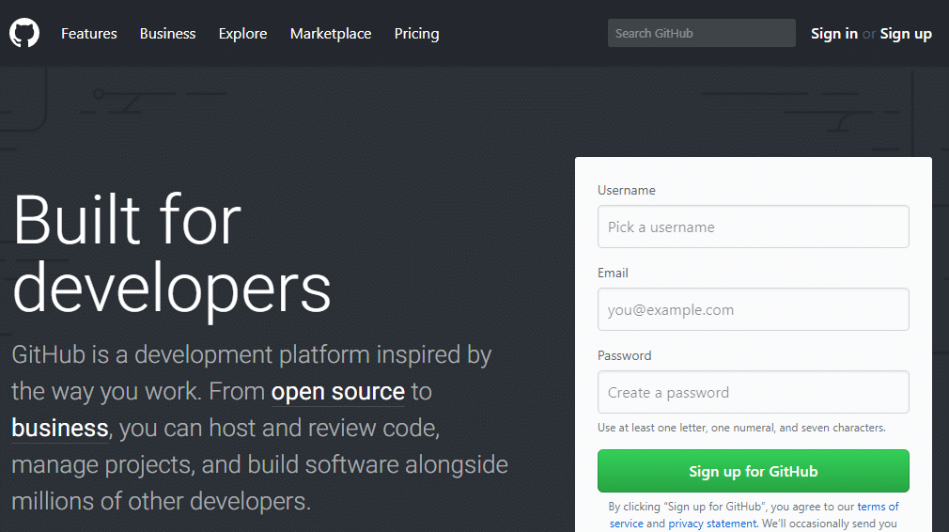
So what then is GITHUB ?

Slide 9






Cloud based Git Repository

Slide 10
GITHUB
It offers a cloud based git repository hosting service for free.
Meaning you can create a software project and store your code on their servers with the caveat that your code is open source and so can be seen and also used by other developers (open source much !!!) unless of course you want to pay.
They also offer free web hosting which is why it is extremely popular with open source projects.

Slide 11
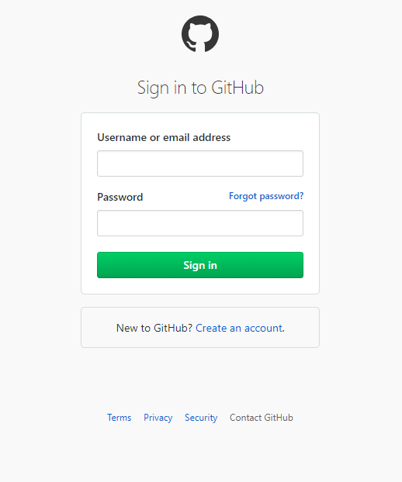
Login to GitHub
Visit https://github.com/
Sign in with your credentials

Slide 12
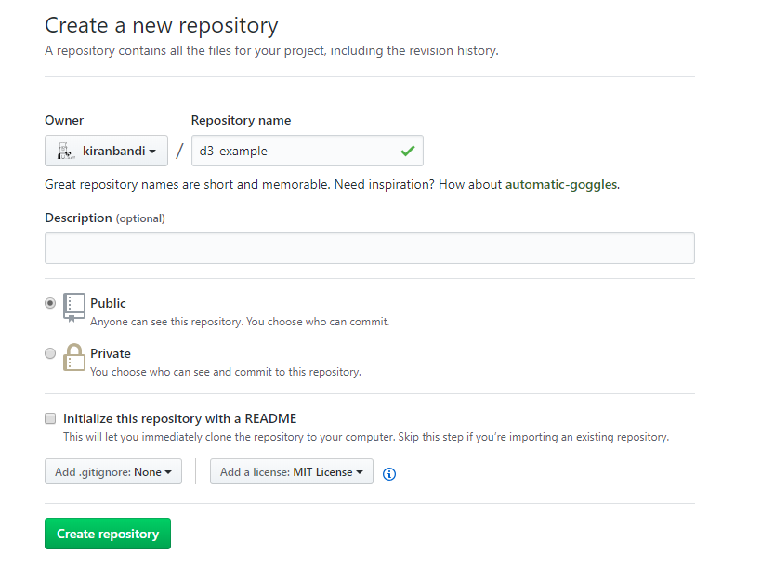
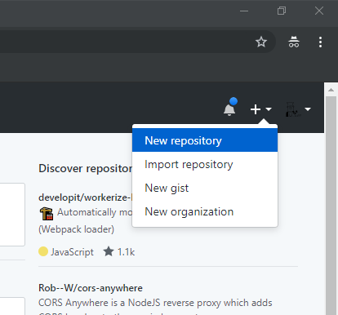
Create a new repository
Click on the + icon in the top right corner and select New Repository
Fill in the details on the next page and select create

Slide 13
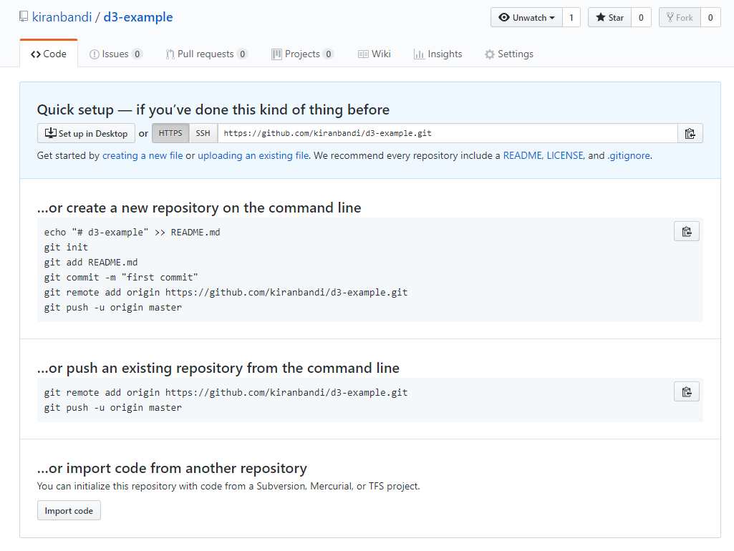
You should see a page like this

Slide 14
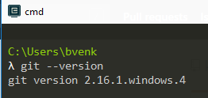
Now clone this repository to your computer.
But before doing that ensure that git is installed if not install it and then proceed.
If you are installing git for the first time you might also want to set your details in your machine.
Check to see if git is installed , if it is you should see a version after you run this command

Slide 15
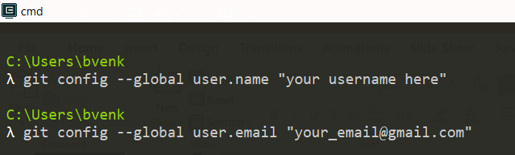
Configuring Git for the first time after installation

Slide 16
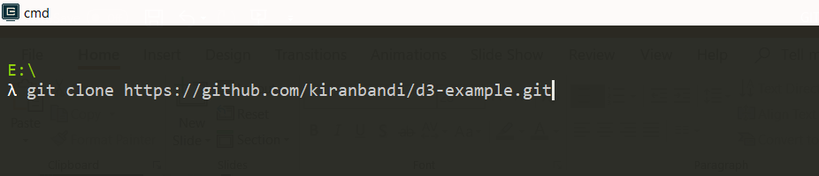
Cloning Repository
Navigate into the path where you want your project to exist
Then run the following command for your repository URL
You can get the URL link from the GitHub page for your repository.

Slide 17
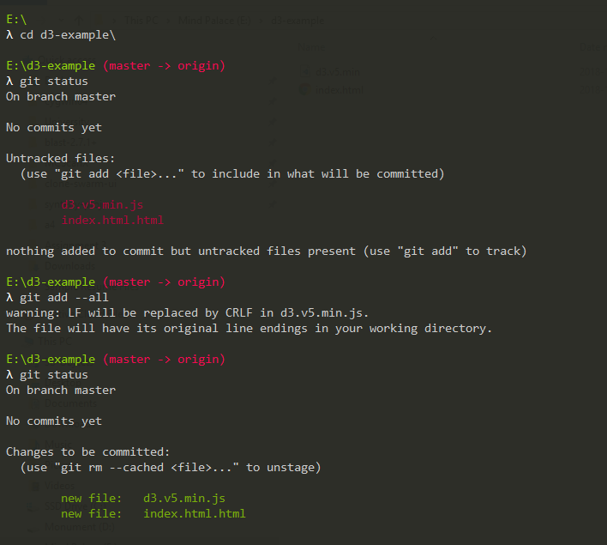
Adding Files to Repository For this simply copy all the files inside the folder called “Sample D3 Files” and paste them in the newly created git folder

Slide 18
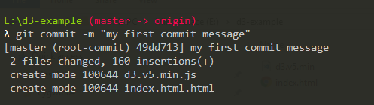
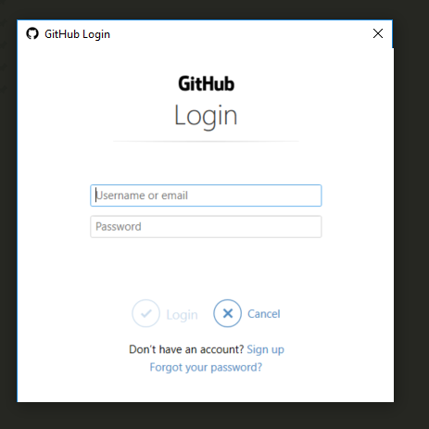
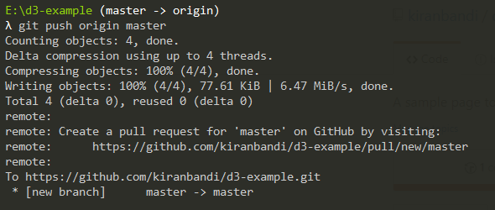

Commit the Files and Push to the Cloud
Create a commit
Then push the commit to the origin which is GitHub for this project , this normally triggers you to re enter your GitHub credentials either on the terminal or through a GUI

Slide 19
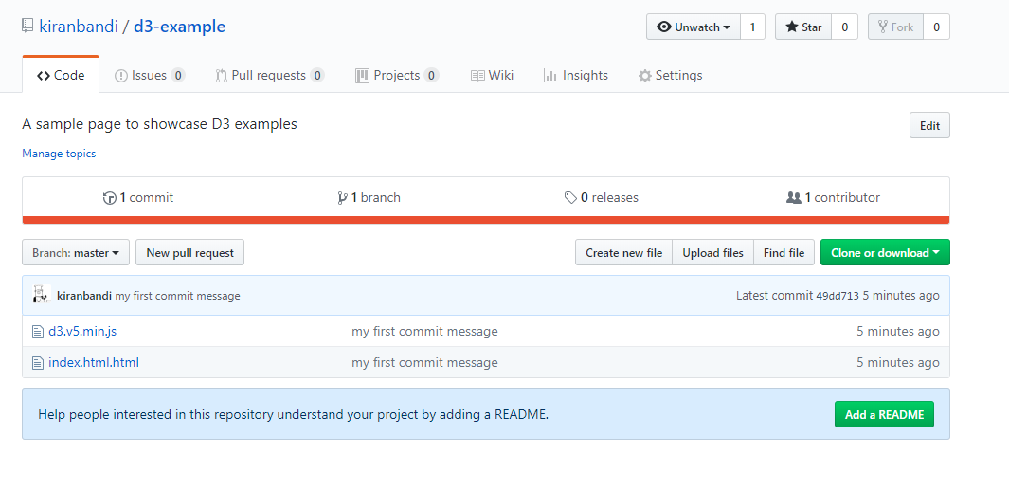
Now go back to the GitHub Repo site and refresh the page , you should see the files you have pushed

Slide 20
There are two ways to publish files on the GitHub Servers
You can create a new branch called gh-pages add in all the code that you want to be published and push this branch to the origin
Or you can configure GitHub to host files from your master branch, we will use the second option for the purpose of the demo.

Slide 21
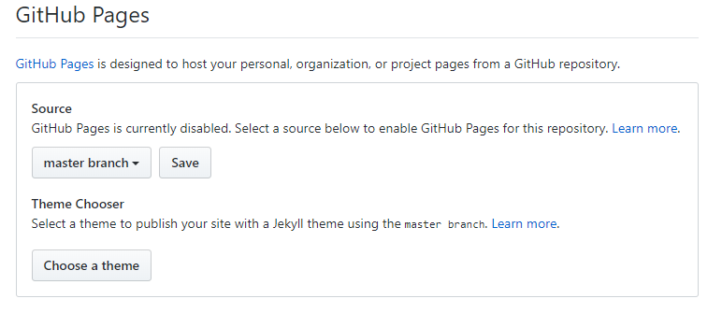
Configure GH-Pages for Master Branch
Click on Settings
Scroll down to the GitHub Pages section and set the source to master branch and save it.

Slide 22
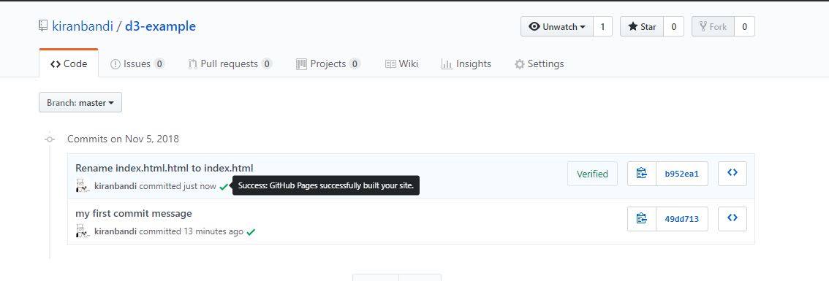
Wait for GitHub to deploy your Site , this can take anywhere from 5 secs to almost a full minute.
You should see a green tick next to your commits indicating that files for that commit have been published.
Clicking on the tick should take you to the published site.

Slide 23
The published URL for the site is based on your username and the repository name.
https://kiranbandi.github.io/d3-example/
Username - kiranbandi , Repository Name - d3-example
GitHub also lets each user create one personal webpage , so if you create a repository called
kiranbandi.github.io or in your case your_github_username.github.io
Then all the files that repository will be directly served at the URL –
kiranbandi.github.io or your_github_username.github.io
This feature is used by a lot of open source web developers to create their own personal websites and blogs hosted through GitHub for free.

Slide 24
Personal Website
Try creating a new repository called Resume
This time use the files in the folder called “Sample Resume Files”
The files have been modified from an existing open source project available here - https://codepen.io/ttdinh/pen/PNqYYE
Modify the files with your own information and repeat all the previous steps and publish the site.
If published successfully you should have your own website with a link that you can share to people , and even provide on LinkedIn or on your CV.

Slide 25
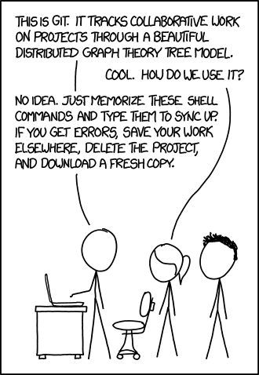
Use Git and GitHub to host and share your projects for free
Reference - XKCD Comics

